Slide 1


Faisal Haroon
7 Sep 2025

Slide 2

Outline
Executive Summary
Introduction
Methodology
Results
Conclusion
Appendix

Slide 3

Section 1

Slide 4
Methodology
Executive Summary
Data collection methodology:
Data was collected through SpaceX API and Web scraping on Wikipedia.
Perform data wrangling
Check data for null and remove all null value from data
Perform exploratory data analysis (EDA) using visualization and SQL
Perform interactive visual analytics using Folium and Plotly Dash
Perform predictive analysis using classification models
Build, tune, evaluate classification models

Slide 5
Data Collection
Data was collected using a combination of retrieval techniques:
HTTP requests against various SpaceX API endpoints:
Initial launch data was obtained from: /v4/launches/past
Additional data was backfilled from:
/v4/rockets
/v4/launchpads
/v4/payloads
/v4/cores
Tabular data from the List of Falcon 9 and Falcon Heavy launches Wikipedia page.

Slide 6
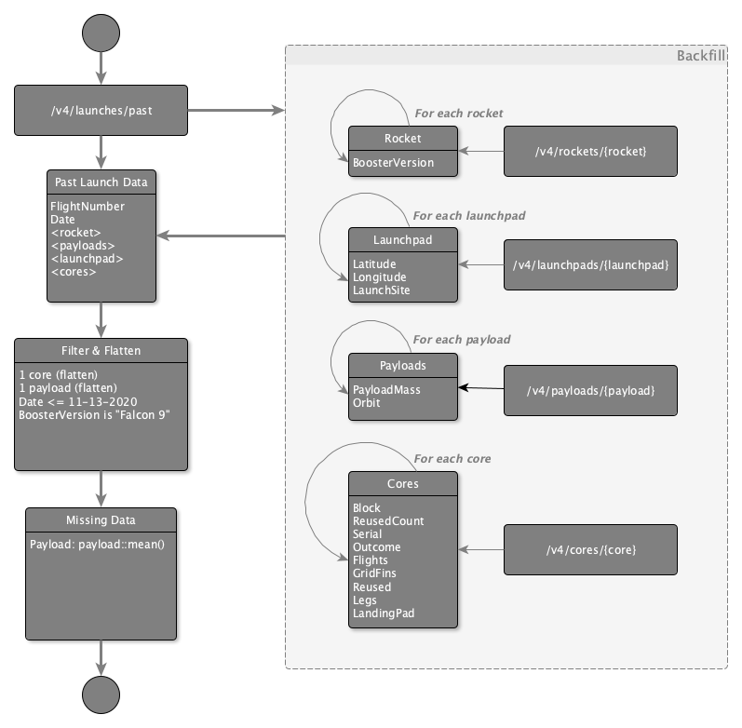
Data Collection – SpaceX API
The initial data was obtained from the `/v4/launches/past` API endpoint.
Additional data was backfilled from the `rocket`, `launchpad`, `payloads`, and `cores` API endpoints, for records with extant corresponding IDs.
GitHub Link

Slide 7
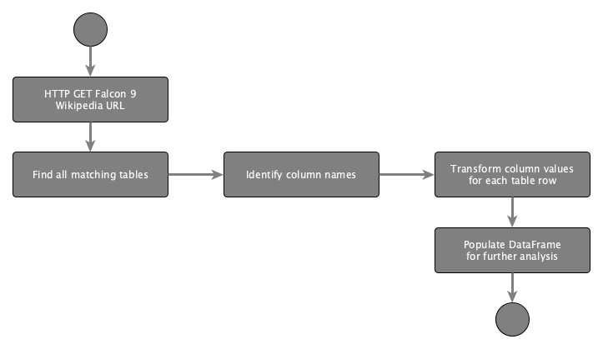
Data Collection - Scraping
Web scraping workflow:
Send HTTP Get to Falcon 9 Launch page at Wikipedia, to retrieve the HTML source
Create a BeautifulSoup object to extract the tables containing launch data
Populate a Pandas DataFrame using the extracted columns
GitHub Link

Slide 8
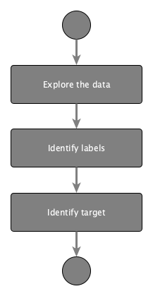
Data Wrangling
Goals:
Use Exploratory Data Analysis (EDA) to find patterns in the data.
Determine the labels for training supervised models.
Steps:
Find missing values as a percentage of each attribute
Identify column types, numerical or categorical
Show launches per Launch Site
Show distribution of Orbit type in the data set
Explore outcomes, and group them by binary outcome (success or failure)
Store outcome as "Class" label, to be used as target value in training
GitHub Link

Slide 9
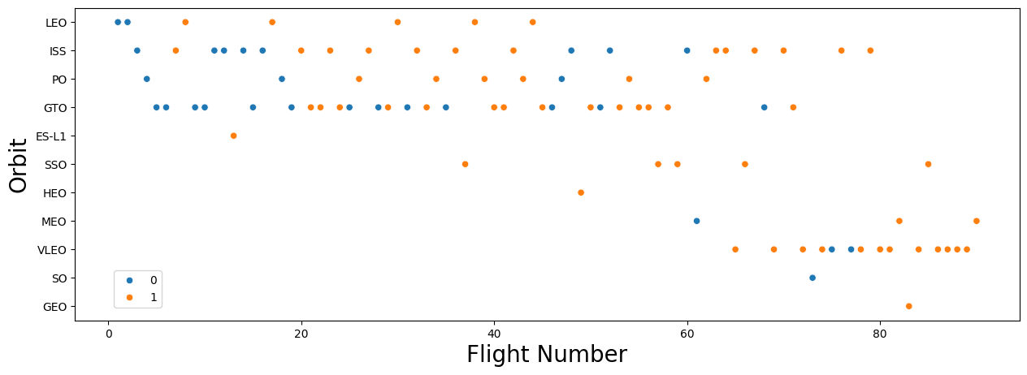
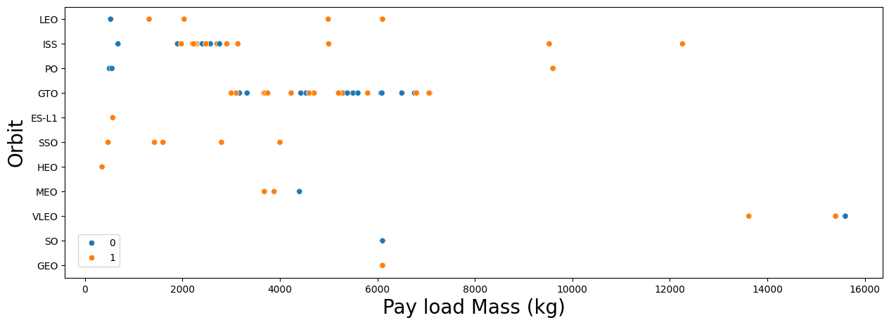
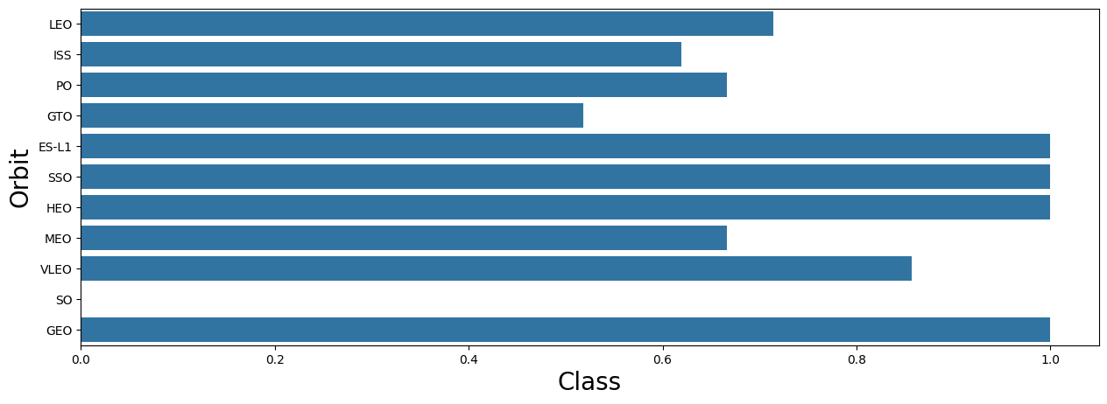
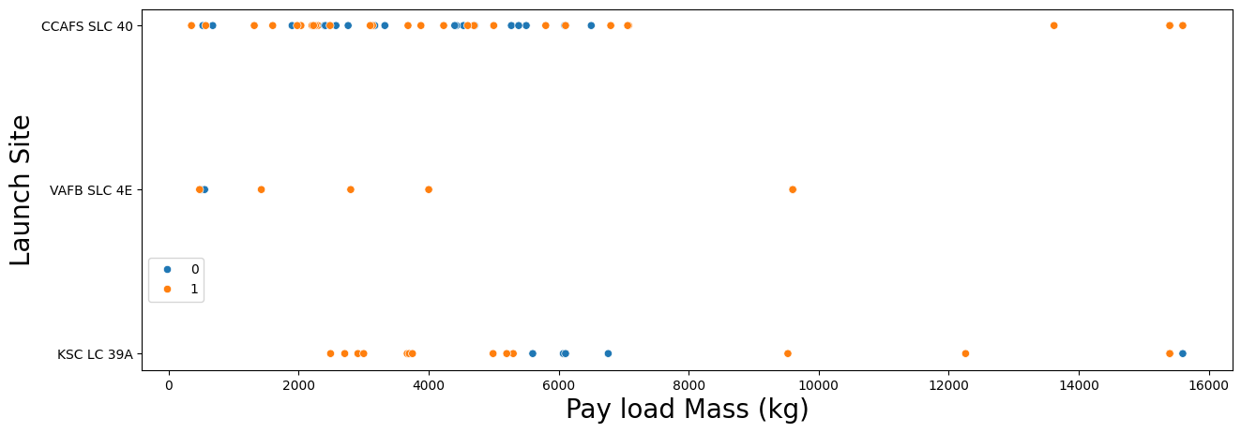
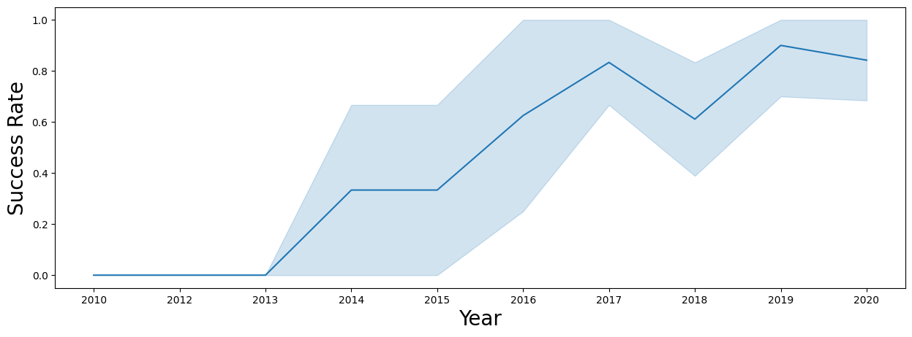
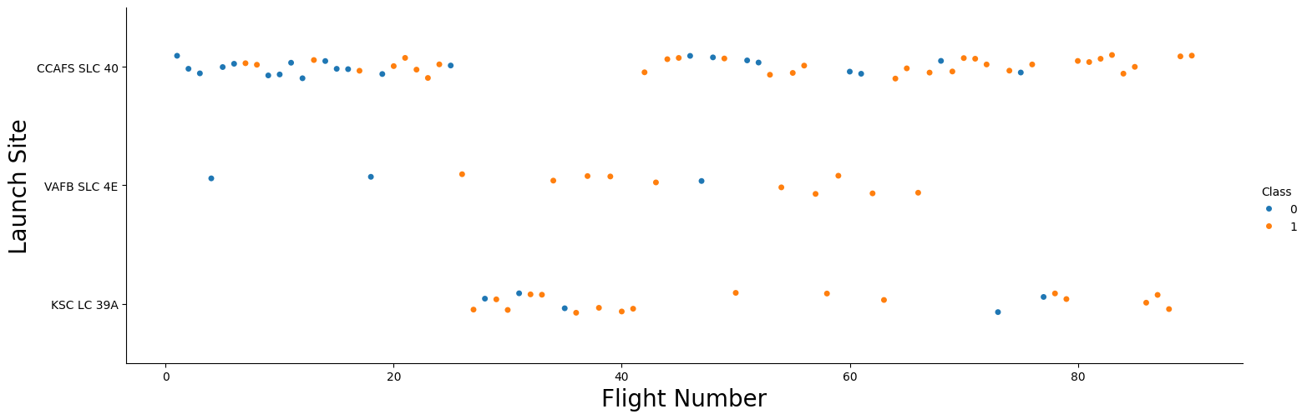
EDA with Data Visualization
Visualize relationships to gain insight into the importance of each variable:
Flight Number and Outcome
Flight Number and Launch Site
Payload and Launch Site
Orbit and Outcome
Flight Number and Orbit
Payload and Orbit
Yearly success rate
Expand categorical variables into "dummy" columns
Convert numerical columns into float64
GitHub Link

Slide 10
EDA with SQL
SQL Queries Performed:
Show each unique launch site
Show 5 records where launch site names begin with 'CCA'
Display the total payload mass carried by boosters launched by 'NASA (CRS)'
Display the average payload mass carried by the v1.1 Falcon 9 booster
List the date of the first successful ground landing outcome
List the booster versions with successful outcomes landing on the drone ship with payloads between 4000kg and 6000kg.
List the number of successful and failed mission outcomes
List all of the booster versions that carried the max payload mass
List the month name, outcome, booster version, and launch site for missions with failure outcomes landing on a drone ship in 2015.
Show the distribution of outcomes between June 4th, 2010 and March 20th, 2017
GitHub Link

Slide 11
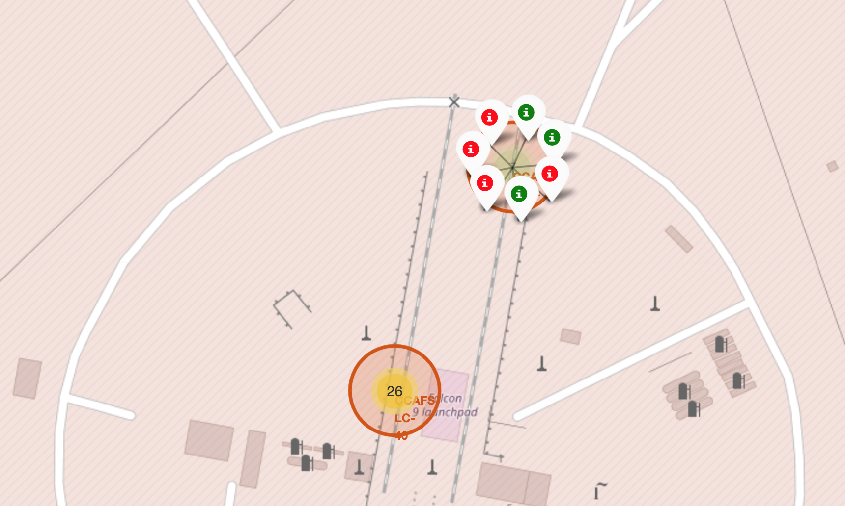
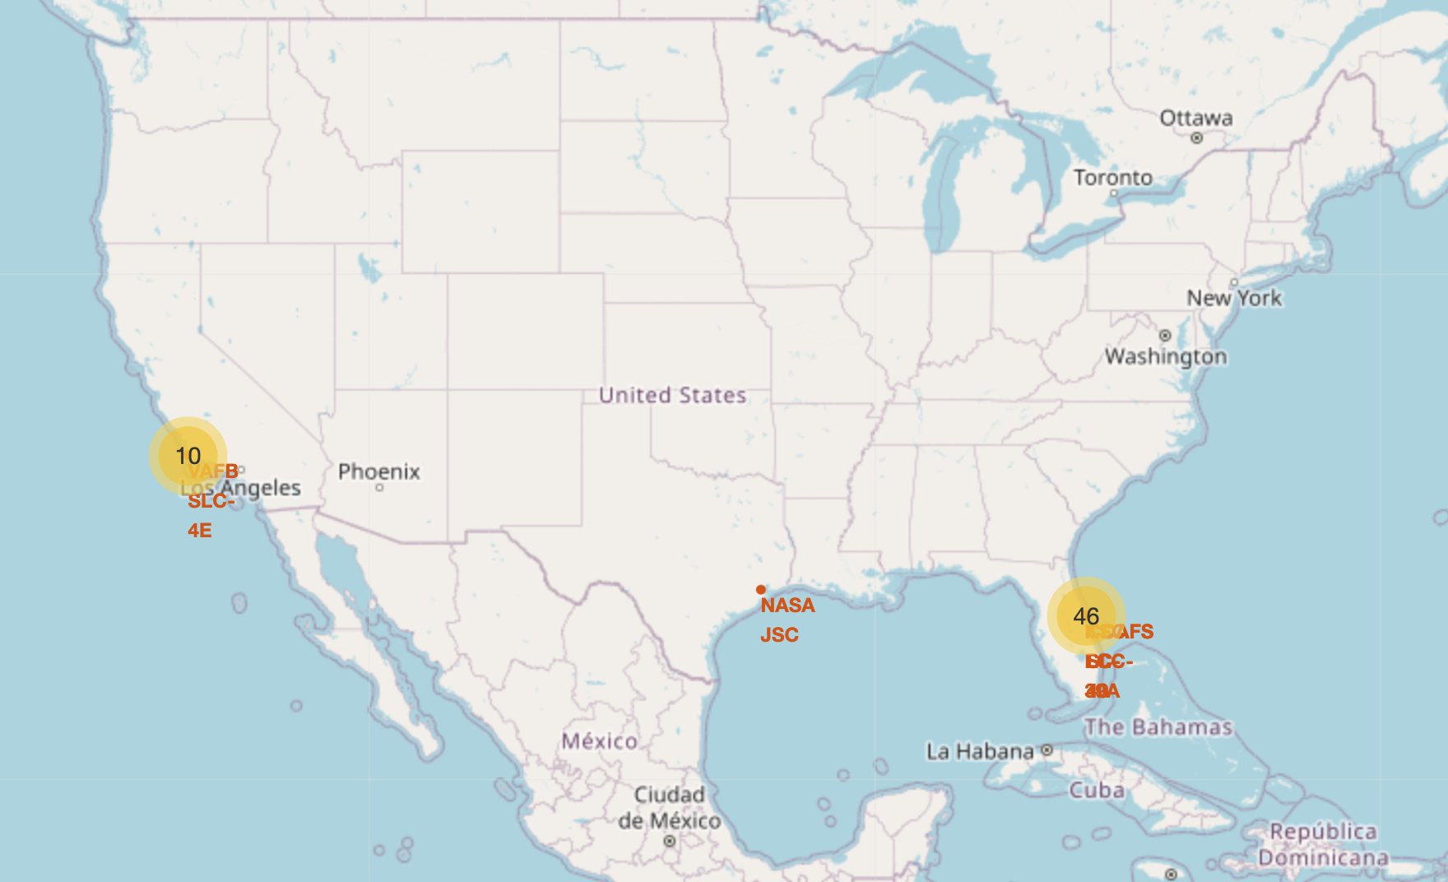
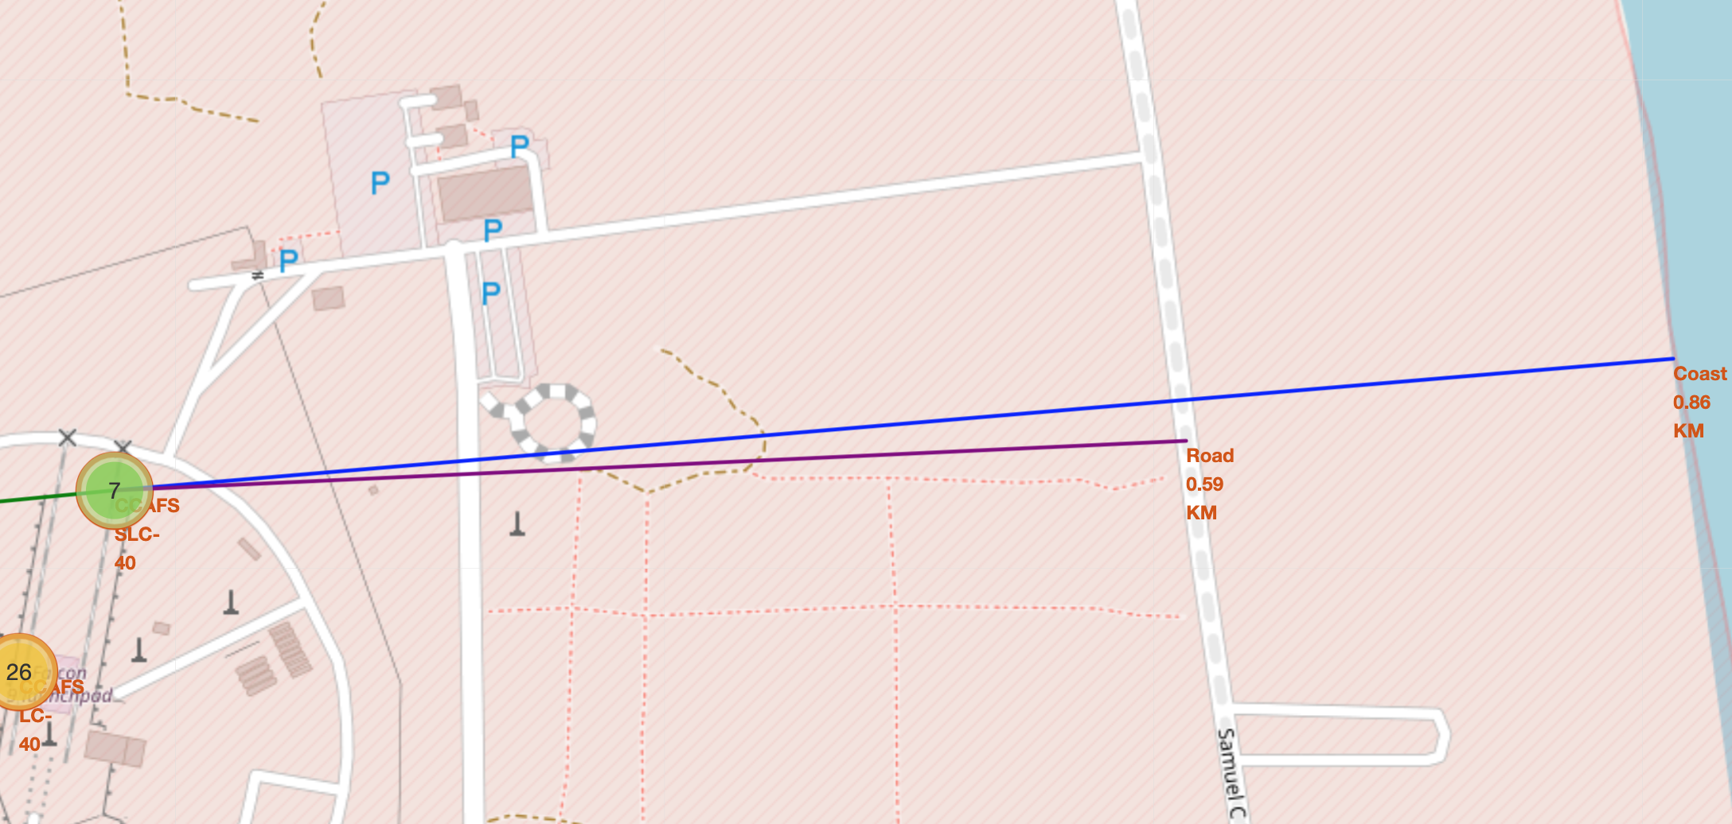
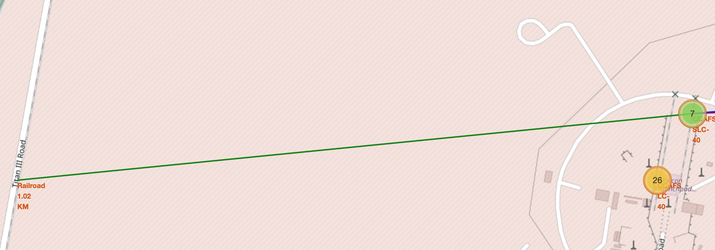
Build an Interactive Map with Folium
To find geographical patterns in the data the following items were marked on a map of launch sites:
All Launch Sites
Successful and Failed Launches
Distances between a launch site and proximate landmarks
GitHub Link

Slide 12
Build a Dashboard with Plotly Dash
To enable interactive exploration of the data, a Plotly Dash dashboard was developed to include:
A dropdown selector to choose a Launch Site, affecting:
A pie chart
All sites selected: shows the breakdown of successful outcomes across all sites
A launch site selected: shows the breakdown of successful vs failed launches for the given site
A scatter plot
All sites selected: shows outcome by payload mass and booster version for all sites
A launch site selected: shows outcome by payload mass and booster version for the given site
A Payload Mass range selector that filters data points on the scatter plot
GitHub Link

Slide 13
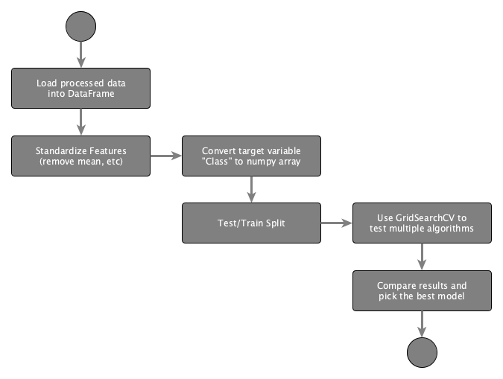
Predictive Analysis (Classification)
Load data
Apply StandardizedScaler on X
Convert Y to numpy array
Split training and testing data
Use GridSearchCV to test hyperparameters for multiple algorithms:
Logistic Regression
SVC
Decision Tree Classifier
K Neighbors Classifier
GitHub Link

Slide 14
Results
Exploratory data analysis results
Interactive analytics demo in screenshots
Predictive analysis results

Slide 15

Section 2

Slide 16
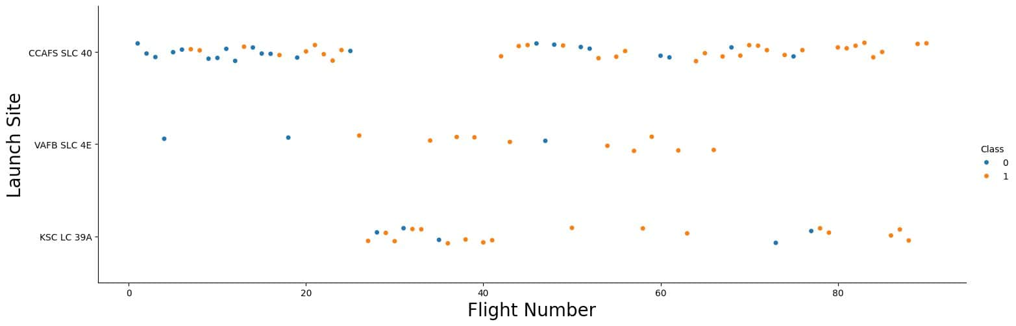
Flight Number vs. Launch Site
All sites show a mix of first stage landing successes and failures, with successes increasing over time.
Early flights predominantly resulted in failures, indicating improvements to technology or process.
While CCAFS SLC 40 has the most total flights, VAFB SLC 4E appears to have a relatively higher proportion of successful landing outcomes.

Slide 17
Payload vs. Launch Site
All sites show a wide range of payload weights, from light to heavy payloads.
Early flights trend toward lighter payloads, representing the bulk of the landing failures.
This suggests technological or operational improvements lead to a greater rate of success with heavier payloads.

Slide 18
Success Rate vs. Orbit Type
Some orbits, such as ES-L1, SSO, HEO, and GEO consistently show high success rates.
Others such as GTO show more mixed outcomes, suggesting some orbit types may introduce operational or technological challenges.
With only one launch, there is not enough data for the SO orbit type to provide an accurate analysis.

Slide 19
Flight Number vs. Orbit Type
Many orbits are represented throughout the flight number range, some orbits are not attempted until later flights.
There is a noticeable improvement in landing success as flight numbers increase, indicating an accumulation of experience and ongoing improvements.

Slide 20
Payload vs. Orbit Type
Many orbits are represented across a wide range of payload masses, but others like SSO, MEO, HEO and GEO show a generally lower range.
Orbits with a constrained payload range, tend to show a higher rate of landing success.
While payload mass does not appear to directly determine mission success, its interplay with orbit suggests a significant correlation.

Slide 21
Launch Success Yearly Trend
Yearly trend shows a consistent progression from early challenges to high reliability in first stage landings over time.
From 2016 onward, SpaceX experienced year over year improvement in success rate with a minor setback in 2018.

Slide 22
All Launch Site Names
There are four unique Launch Sites
CCAFS LC-40
VAFB SLC-4E
KSC LC-39A
CCAFS SLC-40
SELECT DISTINCT Launch_Site from SPACEXTABLE;

Slide 23
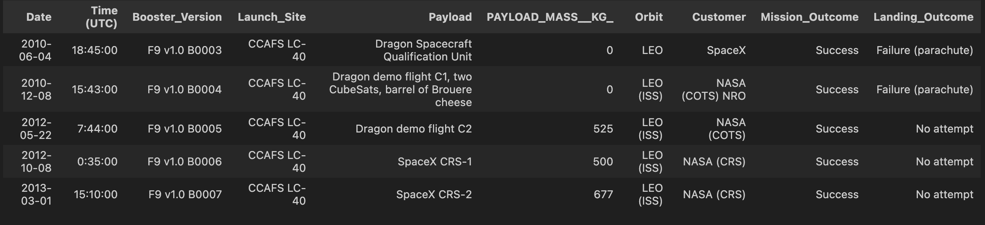
Launch Site Names Begin with 'CCA'
First five records where launch sites begin with `CCA`
SELECT * FROM SPACEXTABLE WHERE Launch_Site LIKE 'CCA%' LIMIT 5;

Slide 24
Total Payload Mass
The total payload carried by boosters from NASA (CRS) is 45,596kg.
SELECT SUM(PAYLOAD_MASS__KG_) AS TOTAL_PAYLOAD
FROM SPACEXTABLE WHERE Customer = 'NASA (CRS)';

Slide 25
Average Payload Mass by F9 v1.1
The average payload mass carried by booster version F9 v1.1 is 2,534.67kg.
SELECT AVG(PAYLOAD_MASS__KG_) AS AVG_PAYLOAD_MASS
FROM SPACEXTABLE WHERE Booster_Version LIKE 'F9 v1.1%';

Slide 26
First Successful Ground Landing Date
The first successful landing outcome on ground pad occurred on December 22nd, 2015.
SELECT MIN(Date) as LaunchDate
FROM SPACEXTABLE
WHERE Landing_Outcome = 'Success (ground pad)';

Slide 27
Successful Drone Ship Landing with Payload between 4000 and 6000
The boosters which have successfully landed on drone ship and had payload mass greater than 4000 but less than 6000 are:
SELECT Booster_Version, PAYLOAD_MASS__KG_
FROM SPACEXTABLE
WHERE Landing_Outcome = 'Success (drone ship)'
AND PAYLOAD_MASS__KG_ BETWEEN 4000 AND 6000;
Booster | Payload Mass
F9 FT B1022 | 4,696kg
F9 FT B1026 | 4,600kg
F9 FT B1021.2 | 5,300kg
F9 FT B1031.2 | 5,200kg

Slide 28
Total Number of Successful and Failure Mission Outcomes
Total number of successful and failure mission outcomes
SELECT CASE
WHEN Mission_Outcome LIKE 'Success%' THEN 'Success'
WHEN Mission_Outcome LIKE 'Failure%' THEN 'Failure'
END as Mission_Status, COUNT(*)
FROM SPACEXTABLE
GROUP BY Mission_Status;
Mission Status | Count
Failure | 1
Success | 100

Slide 29
Boosters Carried Maximum Payload
Booster Version
F9 B5 B1048.4
F9 B5 B1048.5
F9 B5 B1049.4
F9 B5 B1049.5
F9 B5 B1049.7
F9 B5 B1051.3
F9 B5 B1051.4
F9 B5 B1051.6
F9 B5 B1056.4
F9 B5 B1058.3
F9 B5 B1060.2
F9 B5 B1060.3
The maximum payload sent was 15,600kg.
The boosters that carried the maximum payload are:
SELECT
DISTINCT Booster_Version,
PAYLOAD_MASS__KG_
FROM SPACEXTABLE
WHERE PAYLOAD_MASS__KG_ = (
SELECT MAX(PAYLOAD_MASS__KG_) FROM SPACEXTABLE
)
ORDER BY Booster_Version;

Slide 30
2015 Launch Records
List of failed landing outcomes in drone ship, their booster versions, and launch site names for in year 2015:
SELECT
CASE strftime('%m', Date)
WHEN '01' THEN 'January'
WHEN '02' THEN 'February'
WHEN '03' THEN 'March'
WHEN '04' THEN 'April'
WHEN '05' THEN 'May'
WHEN '06' THEN 'June'
WHEN '07' THEN 'July'
WHEN '08' THEN 'August'
WHEN '09' THEN 'September'
WHEN '10' THEN 'October'
WHEN '11' THEN 'November'
WHEN '12' THEN 'December'
END as Month,
Landing_Outcome, Booster_Version, Launch_Site, Date
FROM SPACEXTABLE
WHERE strftime('%Y', Date) = '2015' AND Landing_Outcome = 'Failure (drone ship)';
Month | Outcome | Booster | Launch Site
January | Failure (drone ship) | F9 v1.1 B1012 | CCAFS LC-40
April | Failure (drone ship) | F9 v1.1 B1015 | CCAFS LC-40

Slide 31
Rank Landing Outcomes Between 2010-06-04 and 2017-03-20
Rank the count of landing outcomes between the date 2010-06-04 and 2017-03-20, in descending order:
SELECT
Landing_Outcome,
COUNT(*) as Count
FROM SPACEXTABLE
WHERE
Date BETWEEN
'2010-06-04' AND '2017-03-20'
GROUP BY Landing_Outcome
ORDER BY Count DESC;
Landing Outcome | Count
No attempt | 10
Success (drone ship) | 5
Failure (drone ship) | 5
Success (ground pad) | 3
Controlled (ocean) | 3
Uncontrolled (ocean) | 2
Failure (parachute) | 2
Precluded (drone ship) | 1

Slide 32

Section 3

Slide 33
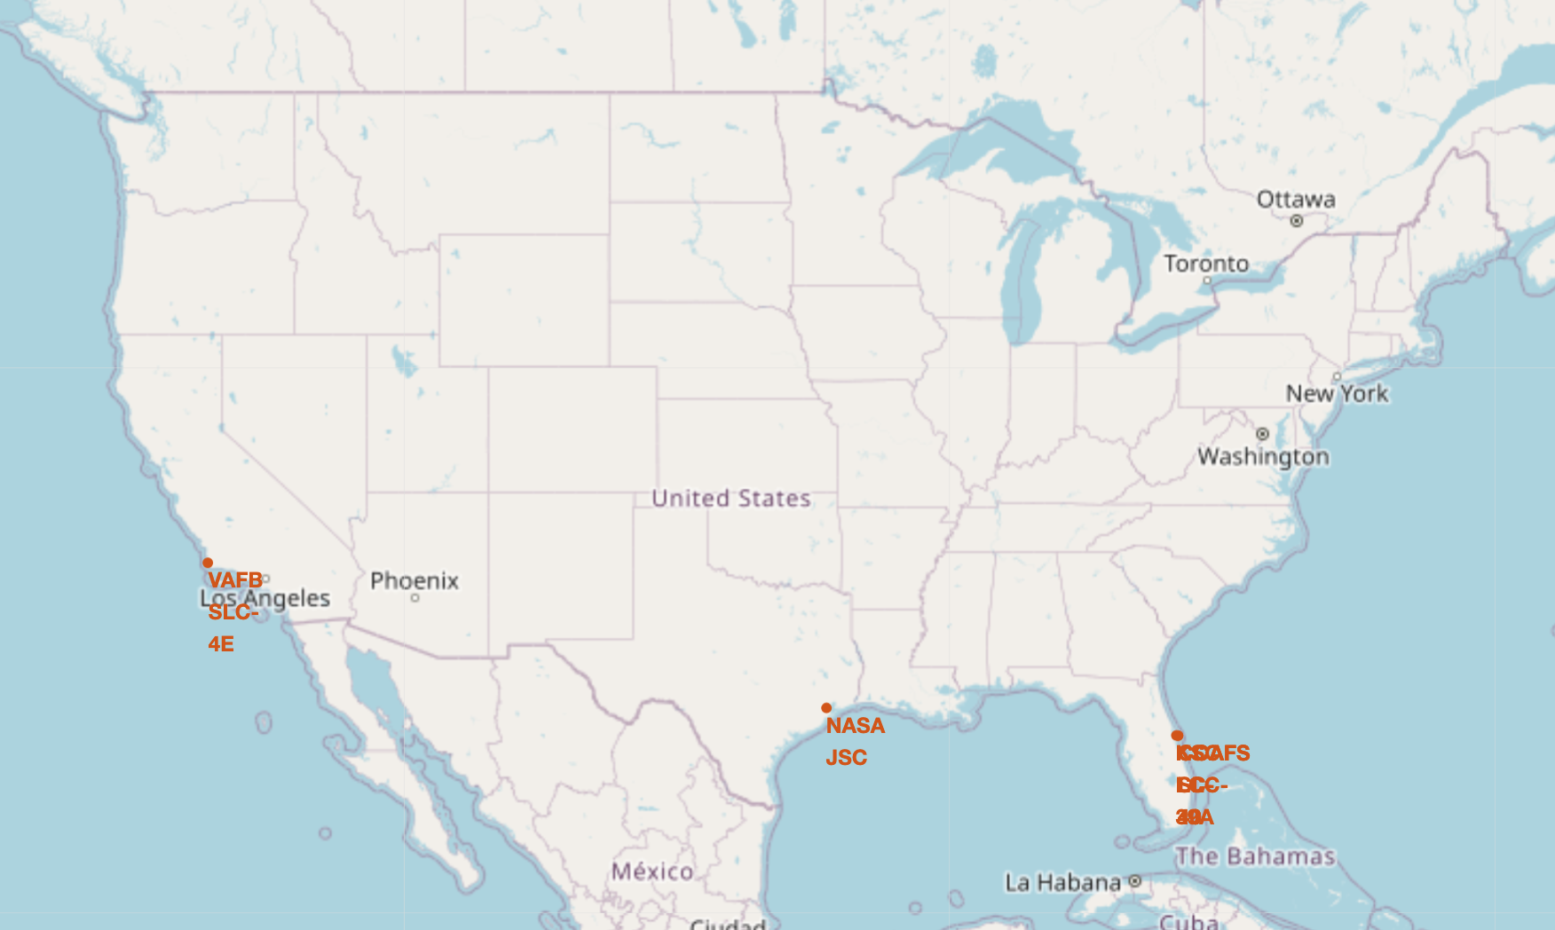
Launch Site Locations
Launch sites are located near coastal regions in Florida and California to reduce risk of catastrophic failures affecting human activities.

Slide 34
Launch Outcomes

Slide 35
Notable Proximate Locations
Notable locations shown
Railway (1.02KM)
Roadway (0.59KM)
Coast (0.86KM)

Slide 36

Section 4

Slide 37
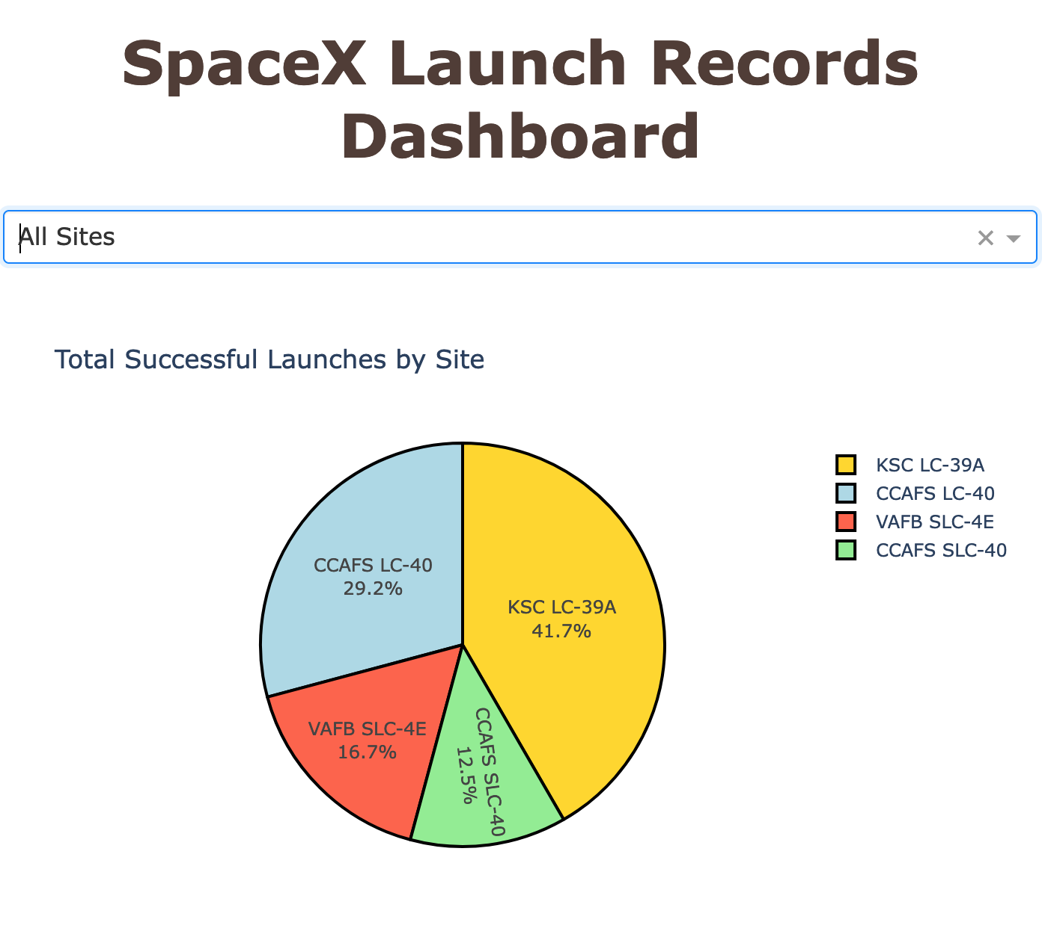
All Launch Sites: Successful Landings
KSC LC-39A experienced the highest proportion of successful landings, followed by CCAFS LC-40.
VAFB SLC-4E and CCAFS SLC-40 the lowest.

Slide 38
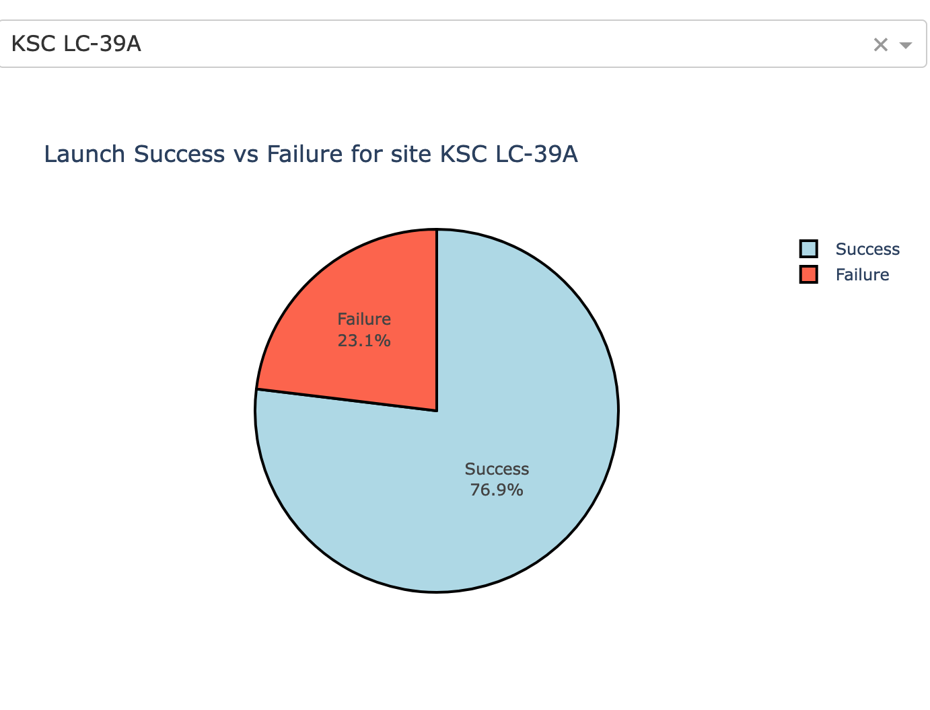
Per-site Launch Success Ratio: High
KSC LC-39A had the highest ratio of successful landings

Slide 39
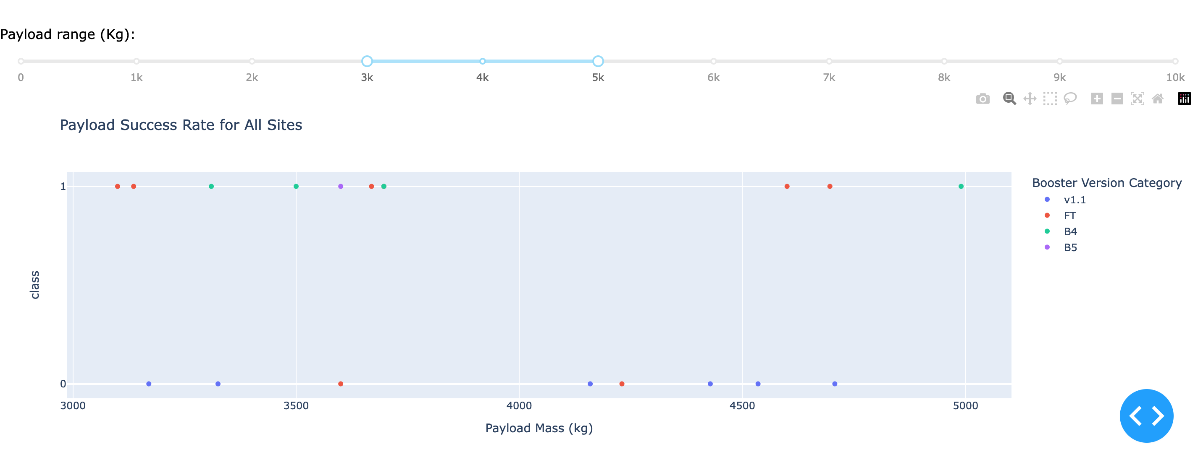
Payload Range
With a payload mass between 3,000kg and 5,000kg, v1.1 boosters performed the worst.
In the same payload range, B4 and B5 boosters had the best success rate, followed by FT.

Slide 40

Section 5

Slide 41
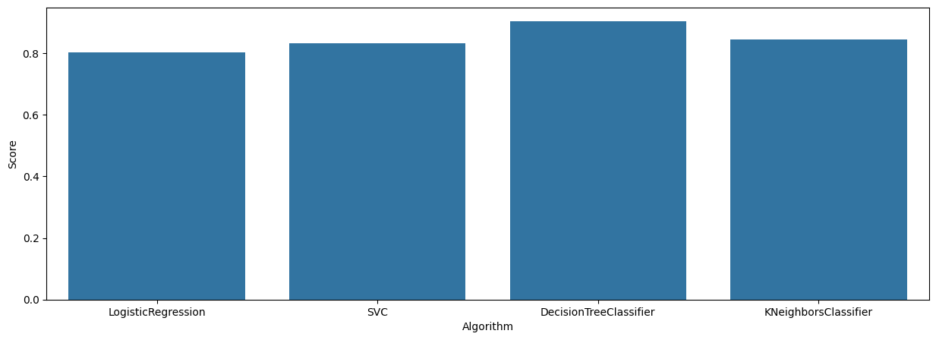
Classification Accuracy
Of the algorithms tested, the DecisionTreeClassifier was the most accurate.

Slide 42
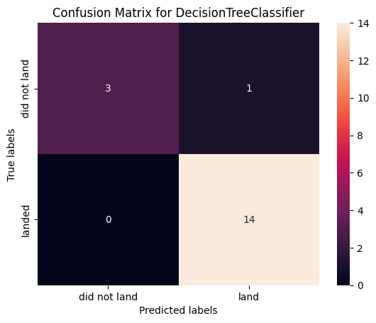
Confusion Matrix
14 observations were correctly predicted as successful landings (true positive)
3 observations were correctly predicted as failed landings (true negative)
1 observation was incorrectly predicted as a successful landing (false positive)
No observations were incorrectly predicted as a failed landing (false negative)

Slide 43
Conclusions
Success rates increase over time, across all factors, which indicates continuous and incremental operational improvements and technological advancements.
Different orbits have varying success rates, with ES-L1, SSO, HEO, and GEO showing consistently successful outcomes.
Launch site was a highly predictive factor, with KSC LC-39A being a top performer, closely followed by CCAFS LC-40.
Many of the predictive models evaluated were able to predict landing outcome with an acceptable level of accuracy. In the testing performed, DecisionTreeClassifier produced best results with high accuracy, precision, and recall.

Slide 44
Appendix
Data Sources
SpaceX API
Collected Data: dataset_part_1.csv
Wikipedia: List of Falcon 9 and Falcon Heavy launches (June 2021)
Data after wrangling: dataset_part_2.csv
Geographical data: spacex_launch_geo.csv
Interactive data source: spacex_launch_dash.csv

Slide 45


